Slide 1

🍴 The Royal Banquet of Formats
“Tonight, the Kingdom serves its finest digital dishes!”

Slide 2
Appetizer: JPEG Delight
Dish Name: Compressed Photo Stew
Description: Light, tasty, and travels easily across the kingdom. Some flavor details may be lost during the cooking process, but it’s perfect for serving large crowds at feasts.
Use Case: Great for online sharing, photos, and everyday meals.

Slide 3
Entrée: PNG Royal Roast
Dish Name: Crisp Transparency Tart
Description: Rich, detailed, and beautifully presented. The secret ingredient is transparency—this dish can blend perfectly with any background. Slightly heavier than JPEG, but worth it for the quality.
Use Case: Ideal for logos, graphics, and digital art

Slide 4
Side Dish: BMP Knight’s Feast
Dish Name: Uncompressed Pixel Pie
Description: A hearty, heavy dish straight from the old kitchens. Pure ingredients, no shortcuts, but extremely filling (and not very efficient to serve).
Use Case: Rarely served today, but valued for its simplicity in old traditions.

Slide 5
Dessert: TIFF Archivist’s Cake
Dish Name: Preserved Layered Pastry
Description: A luxurious, multi-layered dessert that saves every crumb perfectly. Very large in size, but excellent when accuracy and preservation are key.
Use Case: Best for printing, archiving, and professional image storage.

Slide 6
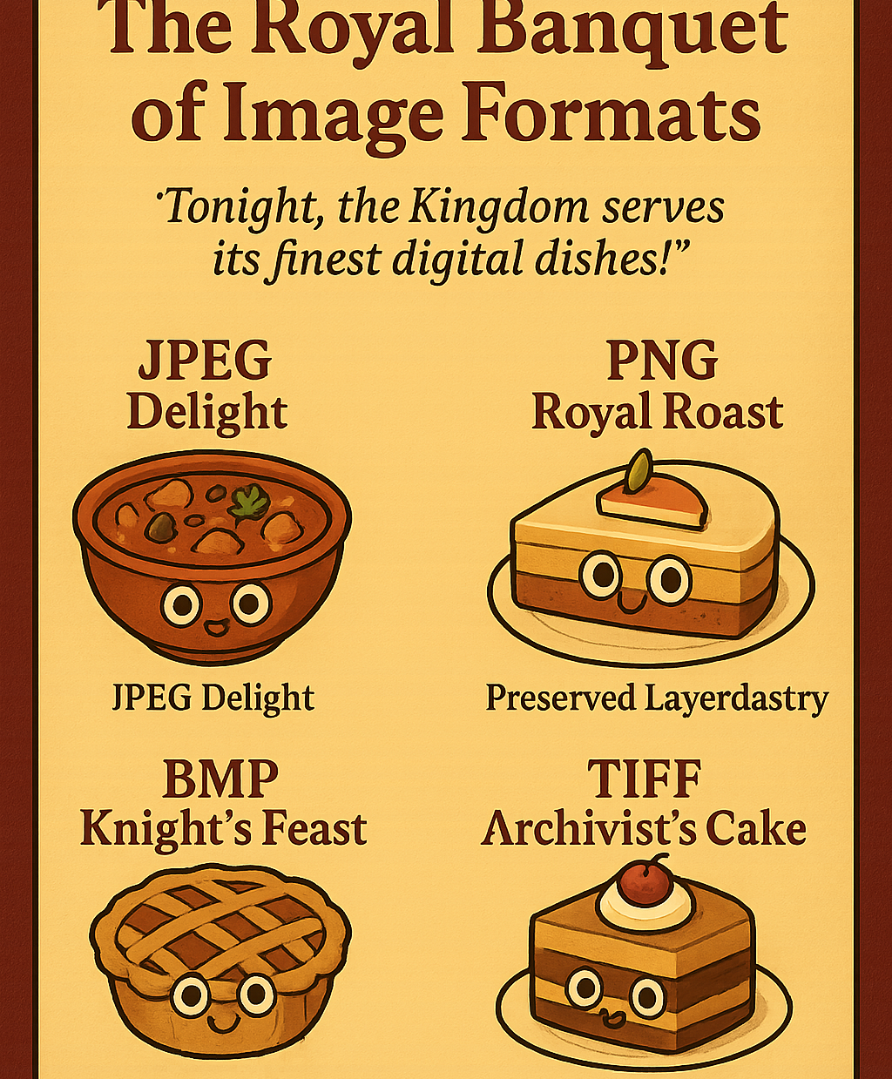
The Banquet Toast
“Every dish brings a flavor to the kingdom. Together, they make the feast complete!”

